Slide 1
Modeling Knowledge

Slide 2
Modeling Knowledge
During the 1970s, knowledge bases were primarily developed through prototyping approaches, enabling the iterative acquisition and representation of domain-specific knowledge.
During the 1990s, formal knowledge engineering methodologies emerged, providing systematic approaches for knowledge acquisition, representation, validation, and maintenance.
KADS and Common KADS (1992) represent a milestone in this field.

Slide 3
Modeling Knowledge: KADS
Knowledge Acquisition and Documentation Structuring:
The organization model supports the analysis of an organization. The goal is to identify problems, opportunities, and potential impacts of the KBS (knowledge based system) development.
The task model describes tasks that are performed or will be performed in the organization.
The agent model describes the capabilities, norms, preferences, and permissions of agents. An agent is the executor of tasks.
The knowledge model gives an implementation-independent description of the knowledge involved in a task.
The communication model describes the communicative transactions between agents.
The design model describes the structure of the system that needs to be constructed.

Slide 4
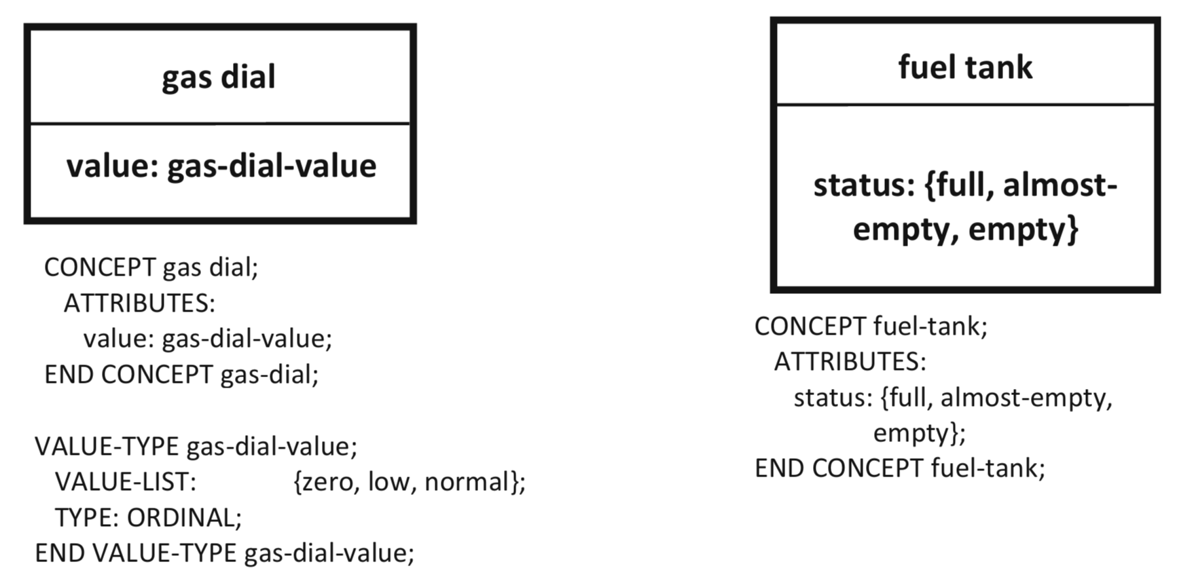
Modeling Knowledge: KADS
The knowledge model:
  domain knowledge represents the relevant domain knowledge and information, mostly static by nature

Slide 5
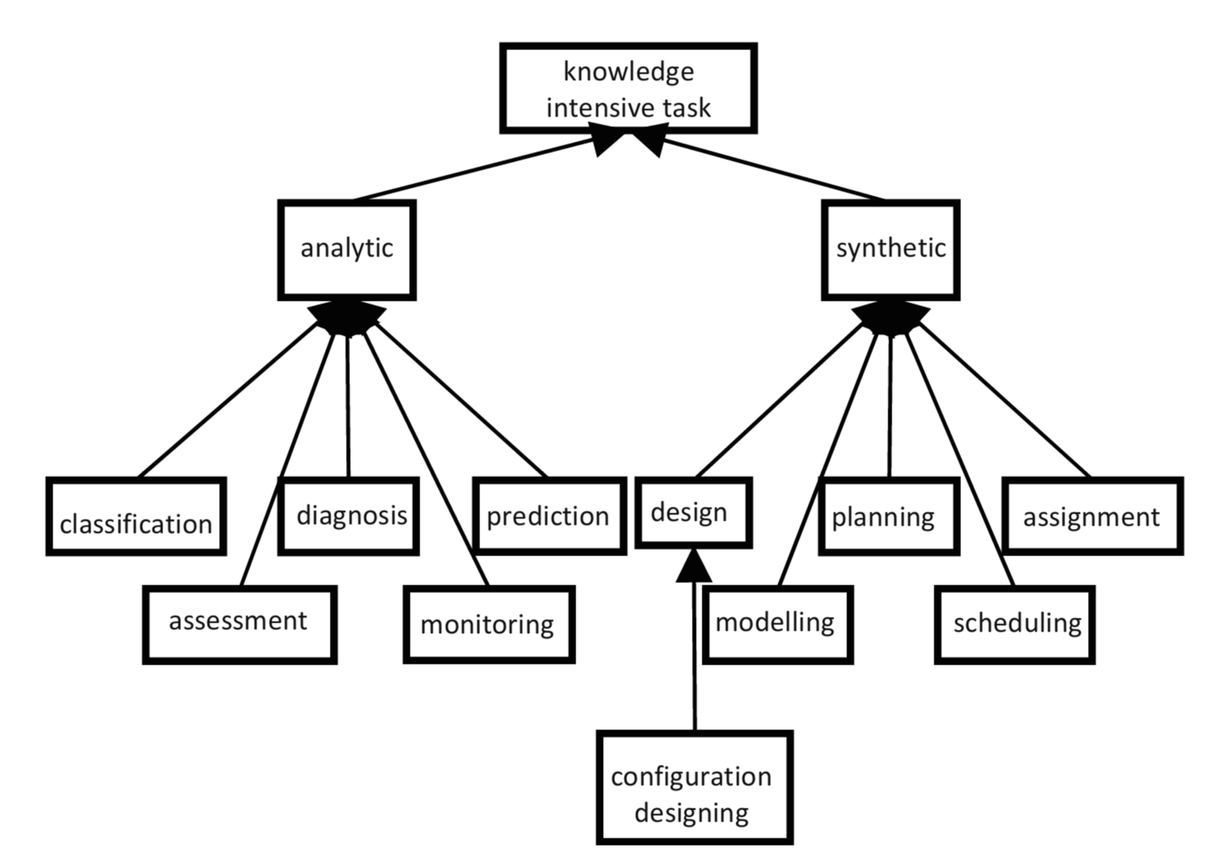
Modeling Knowledge: KADS
The knowledge model:
  task knowledge is goal oriented and provides a higher level of functional decomposition.

Slide 6
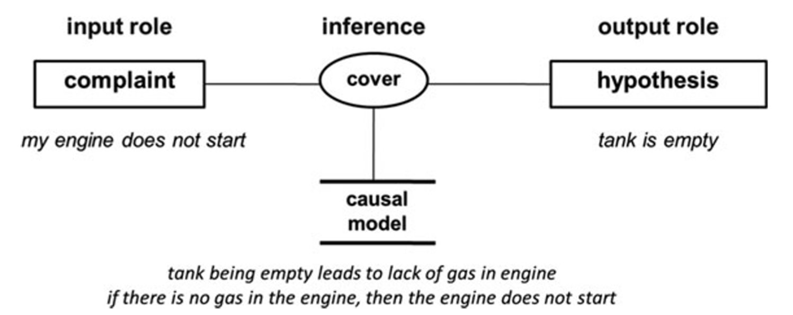
Modeling Knowledge: KADS
The knowledge model:
  inference knowledge models inference actions that are basic reasoning steps that can be made with the domain knowledge and are applied by tasks.

Slide 7
Modeling Knowledge: Ontologies

Slide 8
Modeling Knowledge: Ontologies
Ontologies is the branch of philosophy that studies concepts such as existence, being, becoming, and reality.
It includes the questions of how entities are grouped into basic categories and which of these entities exist on the most fundamental level.
Ontology is sometimes referred to as the science of being.
The goal is to build a model of the world.

Slide 9
Modeling Knowledge: Ontologies
An ontology is formal, explicit specification of a shared conceptualization:
  conceptualization: an abstract model of some part of the world;
  formal: machine-understandable (e.g., formalized with logic);
  explicit: concepts and constraints are explicitly defined;
  shared: captures the knowledge on which a group of people have a consensus;

Slide 10
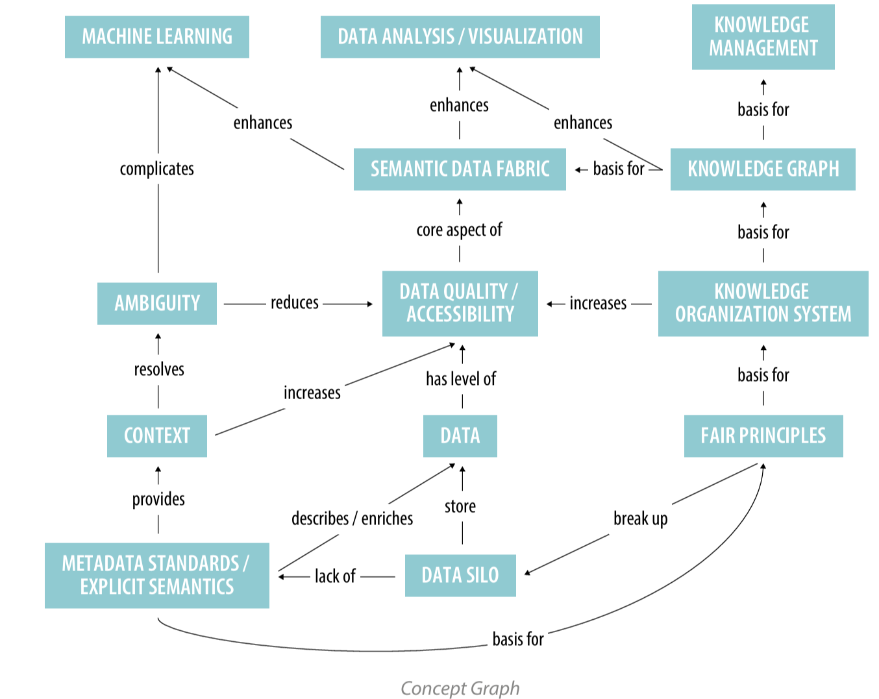
Modeling Knowledge: Ontologies
Challenges:
Acquisition: Collecting and integrating knowledge from different sources.
Quality: Ensuring data is accurate, consistent, and accessible.
Brittleness: Systems can break when data structures or assumptions change.
Maintenance: Keeping knowledge and relationships up to date.
Performance: Ensuring knowledge-based systems operate efficiently.
Ontology and Semantic Web are strictly related​

Slide 11
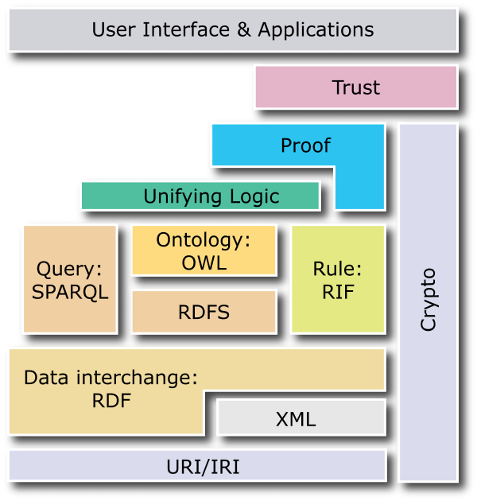
Modeling Knowledge: Ontologies
The Semantic Web, sometimes known as Web 3.0, is an extension of the World Wide Web through standards set by the World Wide Web Consortium (W3C). The goal of the Semantic Web is to make Internet data machine-readable.
Tim Berner's Lee, James Hendler, and Ora Lassila: The Semantic Web is an extension of the current web in which information is given well defined meaning, better enabling computers and people to work in co-operation. [Lee et. al., 2001]
W3C and Tim Berner's Lee: The Semantic Web is a vision: the idea of having data on the web defined and linked in a way that it can be used by machines not just for display purposes , but for automation, integration, and reuse of data across various applications.
Tim Berner's Lee: The Semantic Web will bring structure to the meaningful content of web pages, creating an environment where software agents roaming from page to page can readily carry out sophisticated tasks for users [Shadbolt et al., 2006].

